Slide 1
Slumdog Millionaire: June 5 Lecture Part 3
Major Allusions by Dr. Chowdhury

Slide 2
To Begin with
What is the thematic significance of the open-air opera scene? What is this opera about?
How does this scene become a driving force to push the plot forward?

Slide 3
Answers
French opera based on Greek myth about Orpheus & Eurydice’s undying love
One inspiration for Jamal-Latika’s undying romance
Source of quest motif

Slide 4
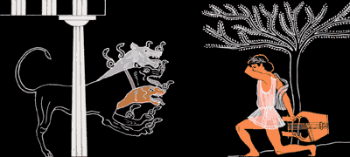
Orpheus Charms Hound of Hell

Slide 5
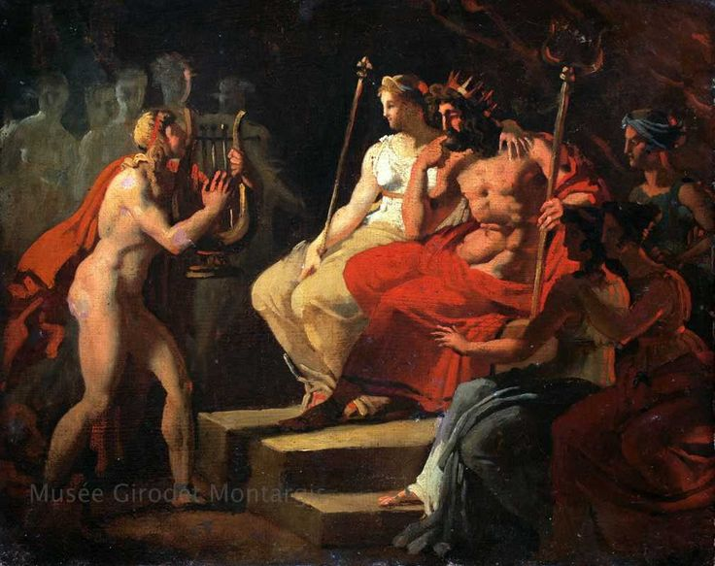
Orpheus Charms King of Hell

Slide 6
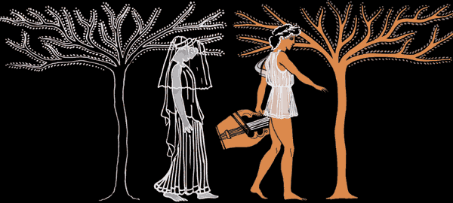
Orpheus Leads Eurydice to World of Living

Slide 7
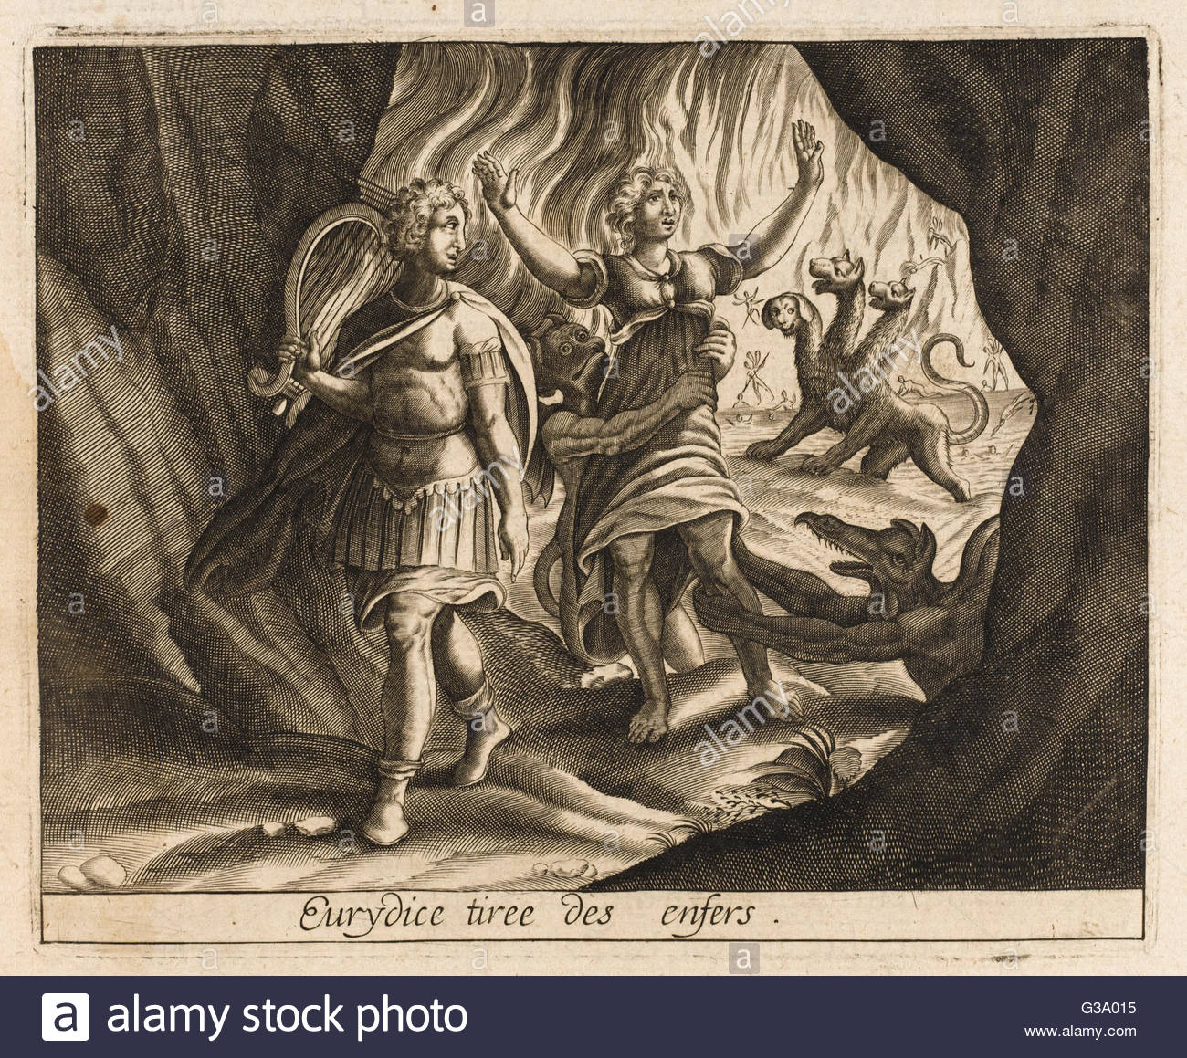
Orpheus Looks Back

Slide 8
From Romance to Romantic
Quest for ideal world
above and beyond material reality
Requires self-sacrifice

Slide 9
The Romantics
Orpheus, Legendary Musician
Surdas, blind Indian Poet
Mughal Crown Prince Khurram---Later Emperor Shah Jahan
Mahatma Gandhi
Jamal
Even Salim?

Slide 10
Film Clips
Blinding of Arvind
The first line of Surdas’s classic song
Jamal answers question about Surdas

Slide 11
Discussion Topics
What could be the significance of the horrific “ritual” of blinding with relation to the theme of romanticism?
Given that the plain English translation of the first two lines of Surdas’ songs is as follows: “My eyes thirst for you, O Thou mysterious God,/ Show yourself to me,” what ironic juxtaposition between idealism and materialism do you find in these scenes?
What can you infer about Arvind’s character with relation to the above from
sniffing out dollar bill
Spoken words to Jamal?

Slide 12
Answers
Surdas’s song is symbolic of
human-divine relationship
Ideal-material tension
Surdas blind to material world but “saw” divine
In 1500s invited to live in Imperial Court by Emperor Akbar
Soon got tired of luxury and retuned to life of ascetic wanderer

Slide 13
Surdas & Taj Mahal Connection
Emperor Khurram (imperial title Shah Jahan) grandson of Akbar the Great
Akbar patron of Surdas
Mughal Emperors patronized holy men & women, poets, seers, priests, fortune tellers, scholars, sorcerers regardless of religion or caste

Slide 14
Taj Mahal--A Personal and Political Symbol
Built by Emperor Shah Jahan, princely name Khurram (reigned 1628–58)
To house favorite wife (since 1612) Arjumand Banu Begum’s remains (died 1631)
Wife given title of Mumtaj Mahal or Taj Mahal (“Crown of the Palace”)
Hence Taj Mahal

Slide 15
Symbol of Personal Grief Turns Political
For 22 years supervised construction while reigning a vast empire
Wished to join her in death
Wish fulfilled under tragic circumstances in 1666
Third Son by Mumtaj dethroned and imprisoned him in 1658 until death in 1666

Slide 16
Personal turned Political
In the Red Fort of Agra (historical fact)
Only consolation Taj Mahal in sight (ditto)
Cried and prayed until lost sight (legend not fact-based history)

Slide 17
The Emperor is Dead; Long Live the Emperor
Shah Jahan interred in Taj Mahal according to Imperial wish
Third Son defeated and killed eldest son chosen by parents to be Emperor
to become only intolerant Muslim ruler of India
Result: protracted civil war and growing influence and final victory of European intruders

Slide 18
More on Taj Mahal Symbolism
Architectural approximation of Islamic paradise
Perfect balance of water, earth, vegetation, and sky
Reminder of eternal world where Emperor would be reunited with wife forever
Symbol of united India
Coming together of Hindu and Islamic architecture

Slide 19
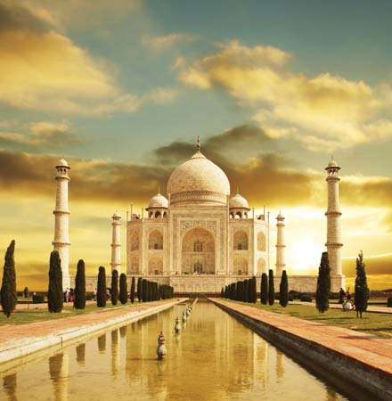
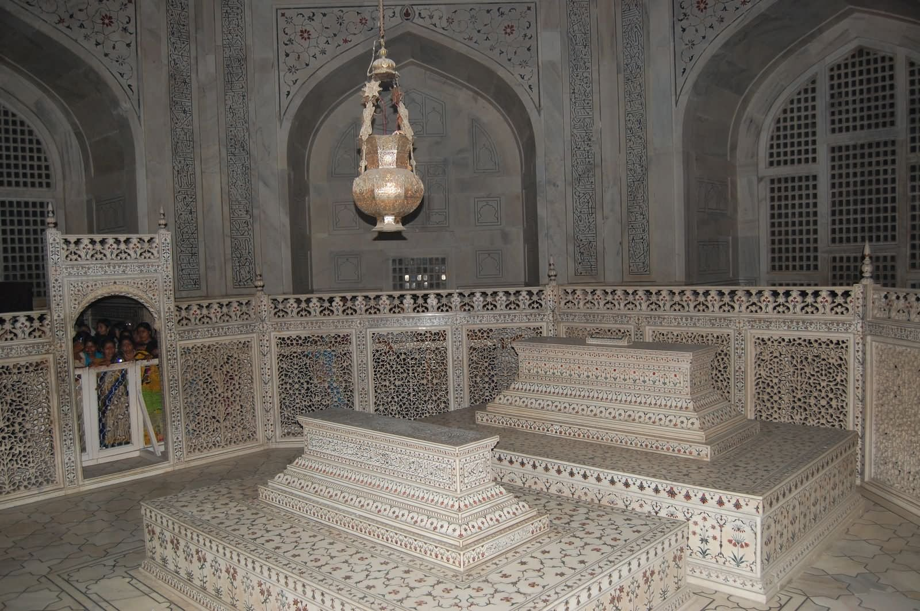
Taj Mahal
Outside
Inside

Slide 20
More Topics to Discuss
What could be the significance of the two references to Gandhi (a. Gandhi's framed and garlanded picture in Police Inspector’s office b. inspector asking Jamal about Gandhi's picture on Indian currency)?
What is Jamal’s attitude reward Gandhi when officer shows him a 1000 Rupee note? What can account for his tone?
What do Benjamin Franklin and Mahatma Gandhi have in common (or not)?

Slide 21
Answers
Franklin & Gandhi both founding fathers
Franklin associated with “rags to riches”
Gandhi went “from three piece suit to rags” by choice

Slide 22
Beginning
Born in a middle caste Hindu Family
Received English education
Obtained Law degree from England

Slide 23
More about Gandhi
Never used diploma to make money
Activism in South Africa
Returned to India to become leader of nationalist movement

Slide 24
Gandhi’s Ideals & Sources
Nonviolence and self-purification
Derived from Indian traditions as well as non-Indian traditions
Bhagavat Gita (Song of Lord Krishna)
Self-control
Karma/Righteous Action without reward
The New Testament
The Qur’an
Henry David Thoreau & Civil Disobedience

Slide 25
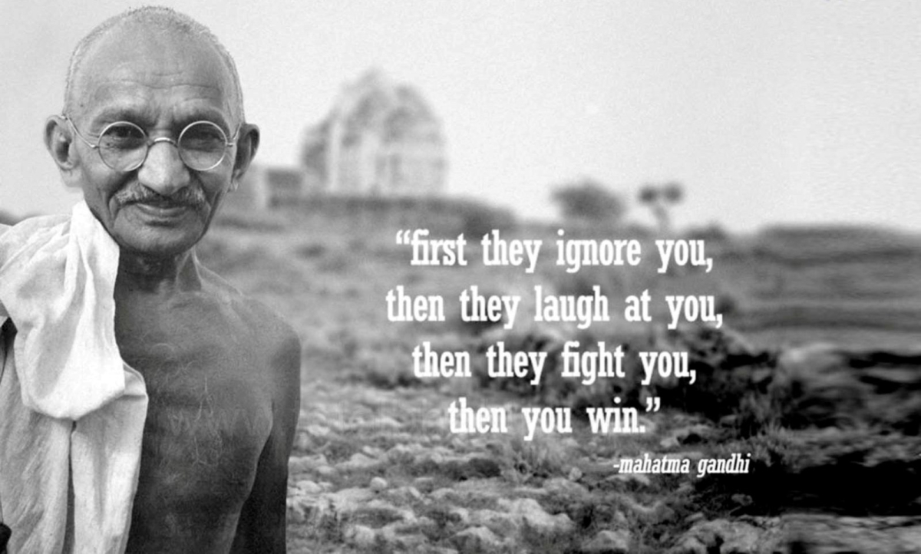
Quotable Gandhi Quote on 70th Anniversary of Assassination

Slide 26
Gandhi and the Untouchables
Gave them new name: Harijans (children of God
Wanted to integrate them into mainstream Indian society
cleaned outhouses and made high caste followers clean as a lesson

Slide 27
Gandhi & Muslims
wanted Muslims to live in peace with Hindus in united India
Vowed to fast until death when Hindu-Muslim riots broke out

Slide 28
Gandhi and “Real Politicians”
Chose not to hold any political office till day of his death
Wore hand-oven traditional fabric
Lacto-vegan
Opposed industrialization and urbanization
Hated consumerism
Left hardly any wealth for family

Slide 29
Gandhi’s Ram vs. Hard-line Hindus’ Ram
His-- loving forgiving God who is same as Muslims’ Allah or the Christians’ Jesus
Disagreed with Hard-line Hindu dream of a Hindu Supremacist State

Slide 30
Gandhi Assassination
Shot dead by Nathuram Godse—an extremist Hindu in 1948
Last words: “Hai Ram!” (Meaning “Oh, Ram!”)

Slide 31
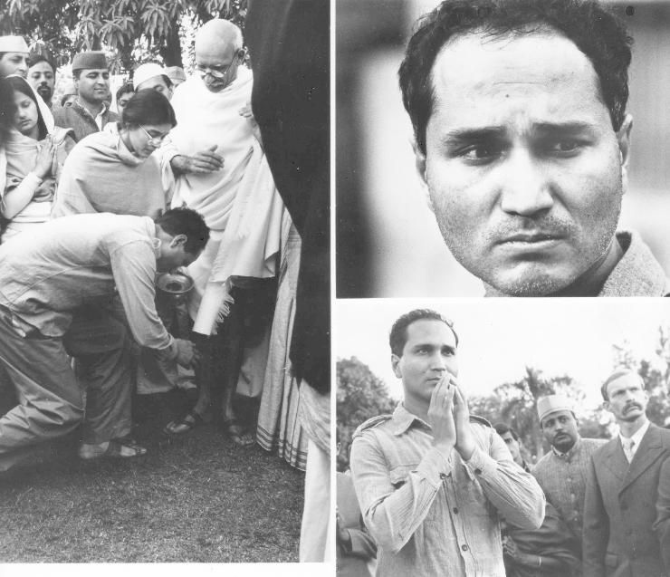
Gandhi & His Killer

Slide 32
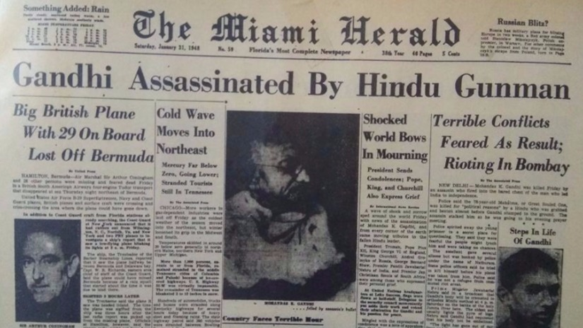
World in Shock and Mourning

Slide 33
Mahatma Gandhi’s Legacy
Dr. Martin Luther King Jr.
“I have a Dream” speech
Nelson “Madiba” Mandela
Free South Africa as a “Rain bow Nation”

Slide 34
Ben Franklin vs. Mahatma Gandhi
Old Ben used religion and spirituality as a means rather than as an end
Franklin's: very practical and worldly philosophy
Father of American entrepreneurship and free-market capitalism
Amassed great personal wealth and became prominent in society held political offices
Owned slaves despite championing freedom

Slide 35
Jamal’s Seeming Disdain
Officer pays homage to Gandhi’s image yet uses torture
21^{st-}Century Indian state uses Gandhi as empty symbol
Does not follow his ideals
state & society based on limitless greed corruption and violence

Slide 36
More Topics
Do you think Jamal is also an idealist/romantic as were Orpheus, Surdas, Emperor Shah Jahan, and even Gandhi? Why or why not?
What about Salim?

